Slide 1
Data analysis
Analysis Tools

Slide 2

Terminologies

Slide 3
What does “Statistics” Mean?
1770, "science dealing with data about the condition of a state or community” from German Statistik.
Modern Latin statisticum collegium –”lecture course on state affairs”
Italian statista "one skilled in statecraft,"

Slide 4
What does “Analysis” Mean?
1580s, "resolution of anything complex into simple elements”
Opposite of synthesis

Slide 5
Analytical
Mind
A bat and ball cost $1.10 in total. If the bat costs a dollar more than the ball, how much does the ball cost?

Slide 6
Types of Analysis
Descriptive Analysis
Exploratory Analysis
Comparative Analysis
Longitudinal Analysis
Inferential Analysis

Slide 7
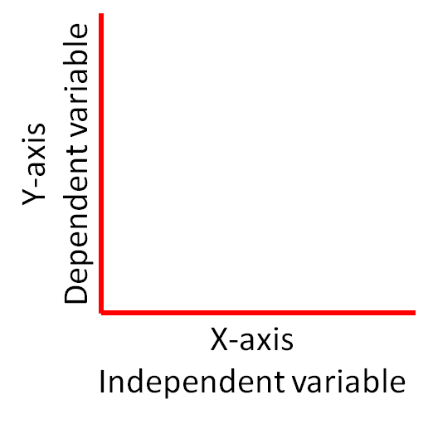
Dependent
&
Independent
Variables

Slide 8
Data Visualization
Visualization Techniques

Slide 9

Ideograms

Slide 10
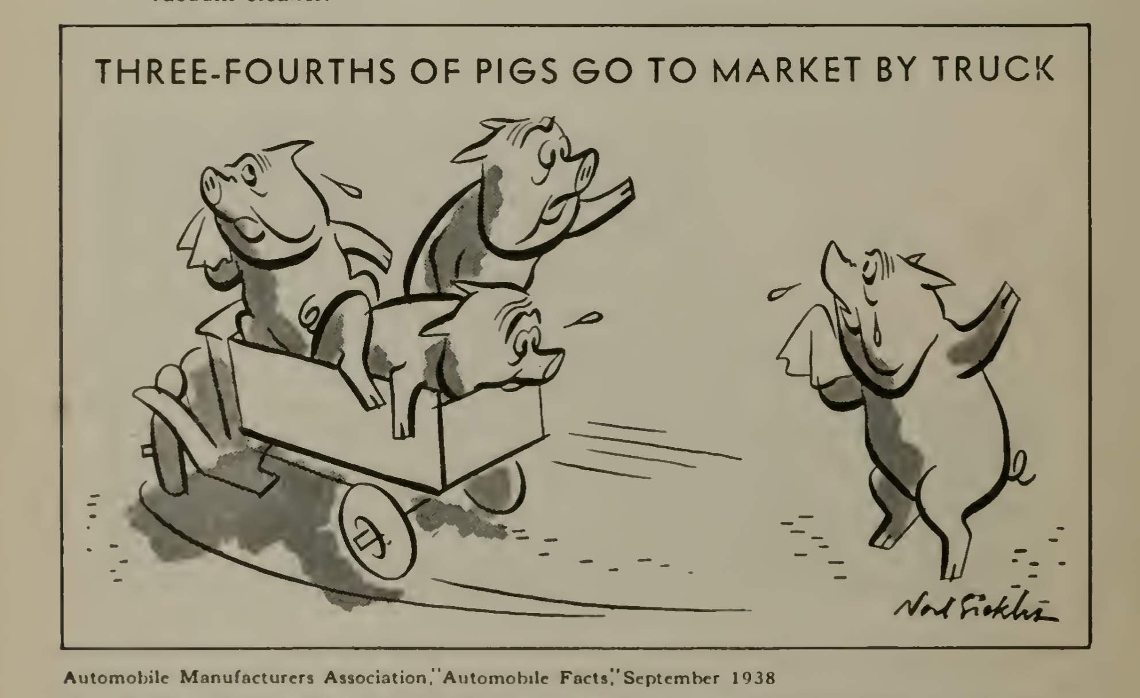

Slide 11
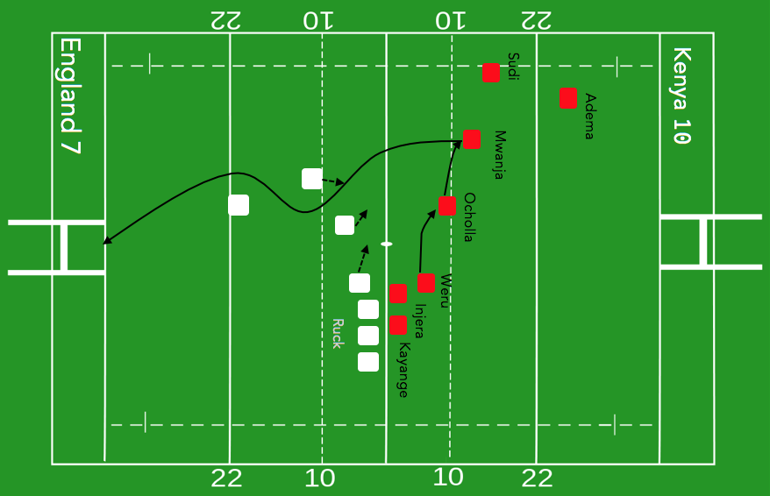

Slide 12
Representing
Statistics
Facebook has found that friends who communicate often are more likely to click on the same advertisement.
Tala – people who call their mother are highly likely to pay back loans.
KNBS – Kenya has enough food for the next 6 months

